Slide 1
Node.js Framework – Express
Minimal & flexible web application framework

Slide 2


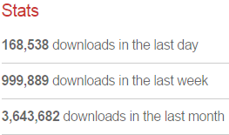
Express
TJ Holowaychuk
Notes:
Express是一个基于Node.js的极简、灵活的web应用开发框架，它提供一系列强大的特性，并且非常轻便的进行你想要的扩展。

Slide 3
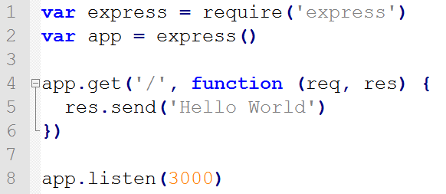
A Simple HTTP Server by Express
$ npm install express --save

Slide 4
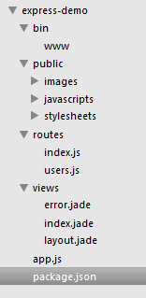
Express generator
Install the generator in global scope
Use generator create a express-app
Start express app
$ npm install express-generator -g
$ express express-demo && cd express-demo
$ npm install
$ npm start

Slide 5
Express Features

Slide 6
Agenda
Routing
Middleware
Database Integration

Slide 7

Routing
HTTP Method
URI (path)
Handler
Notes:
App.METHOD()
App.route()
Express.Router

Slide 8
Routing methods
Support method corresponding HTTP method
GET -> get
POST -> post
* -> all
…

Slide 9
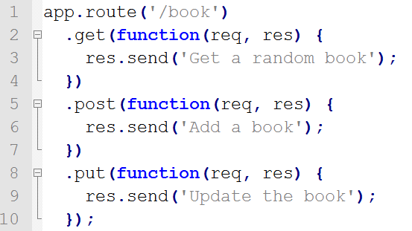
app.route()
Chainable route handler

Slide 10
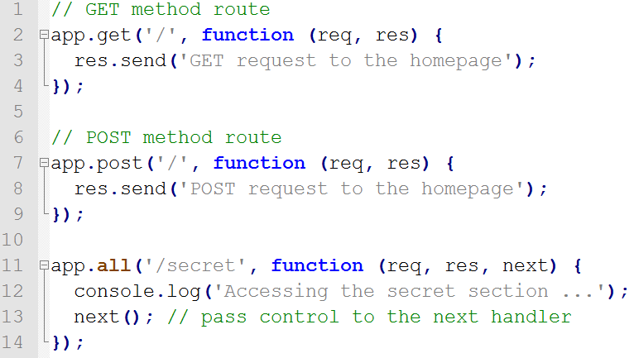
Routing methods

Slide 11
Routing path
Define the endpoints at which requests can be made to
Domain/server address
Request path

Slide 12
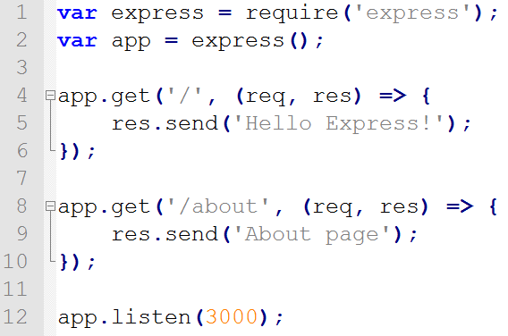
Routing path – string
http://localhost:3000
http://localhost:3000/about

Slide 13
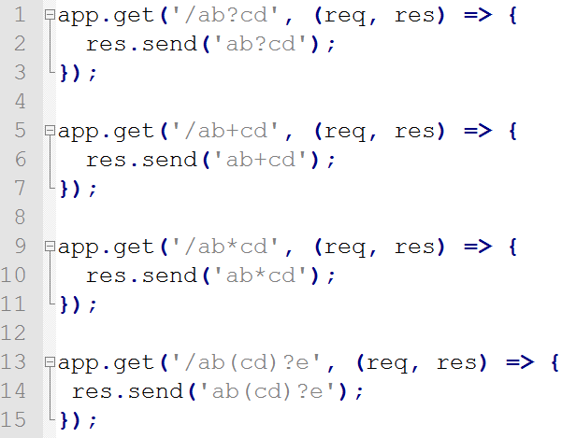
Routing path – string patterns
Support ?, +, * and ()
/acd, /abcd
/abcd, /abbcd, /abbbcd
/abcd, /abxcd, /ab12*cd
/abe, /abcde

Slide 14
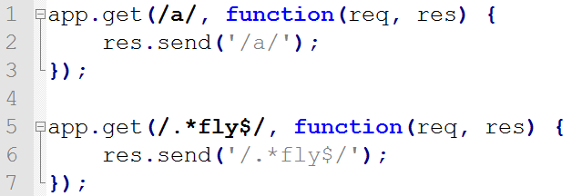
Routing path – regular expression
Use regular expression as a path definition
The path contains a
The path end with fly

Slide 15
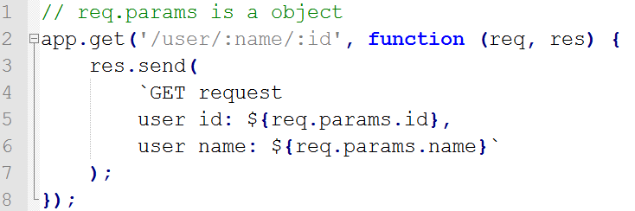
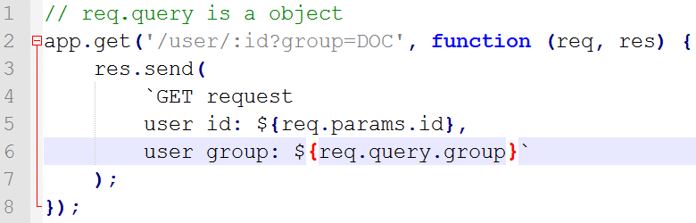
Routing path – parameters
req.params => {}
req.query => {}

Slide 16
Routing path – rule
First definition, first process
Don’t abuse patterns

Slide 17
Routing handlers
Handler
Each handler is a function, handle request & response
Format is
Function
Array of function
Various combination of above both

Slide 18
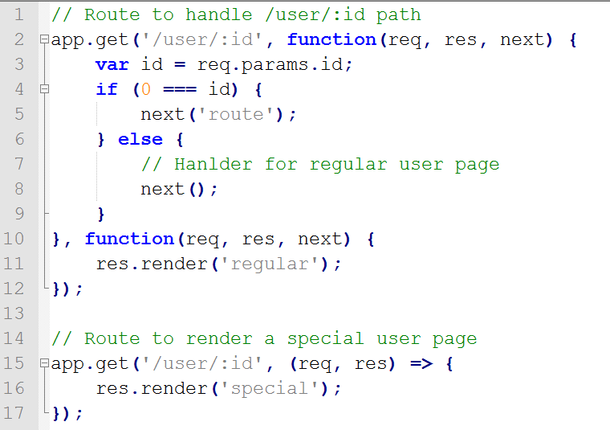
Routing handlers

Slide 19
Routing handlers – rule
Use next() pass control to next handler
Use next(‘route’) pass control to next eligible route
Only works for app.METHOD or router.METHOD

Slide 20
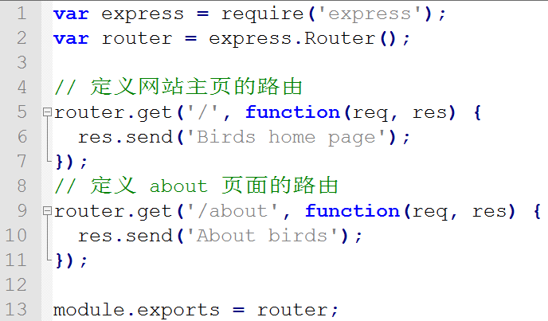

express.Router
/birds, /birds/about
Notes:
http://forbeslindesay.github.io/express-route-tester

Slide 21
express.Router
Good structure & modularization
Complete route system (mini-app)
Iris4-app
/wls_prs_gsp
/wls_prs_doc
/wls_prs_shp

Slide 22
Route - summary
app.METHOD
Path
Handlers
express.Router
app.use()
next()

Slide 23
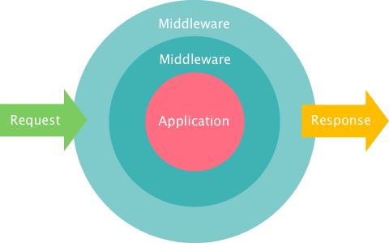
Middleware

Slide 24
Middleware
A function
Can access
HTTP Request & Response
Middleware flow controller -> next

Slide 25


Middleware – normal
Application level
Router level
Notes:
错误处理必须声明4个参数，看了express源代码你能知道，它里面的实现是根据arguments来判断参数个数，从而决定是否是错误中间件

Slide 26
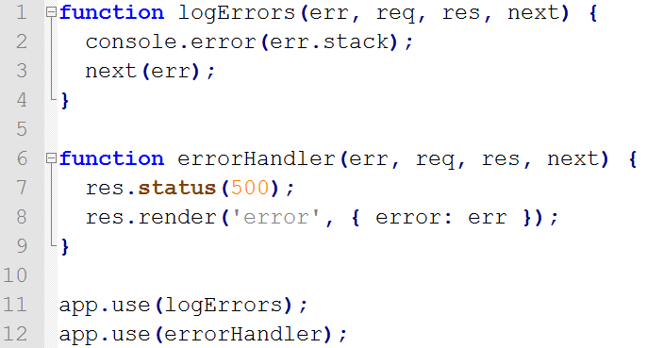
Middleware – error
Error middleware
Must declare 4 parameters
Pass to next error middleware
(err != ‘route’)
No path, means all request will go through this middleware
Notes:
不需要定义path，这里就涉及到use的另外一种写法，就是没有path的情况，这代表所有的请求都要走这个中间件

Slide 27
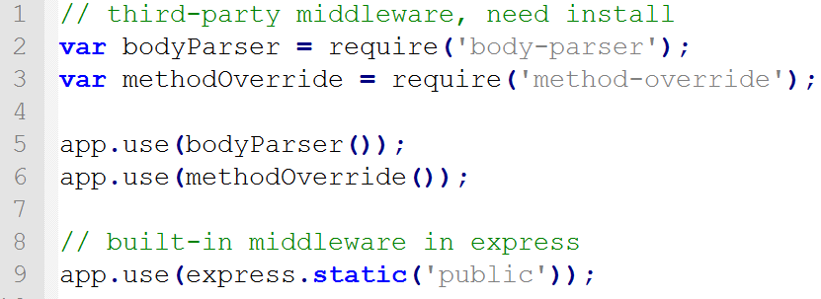
Middleware – third-party
From 4.x, express has not depended on connect any more
Server-static is the only built-in middleware in express
Get more useful middleware from Github - Express

Slide 28
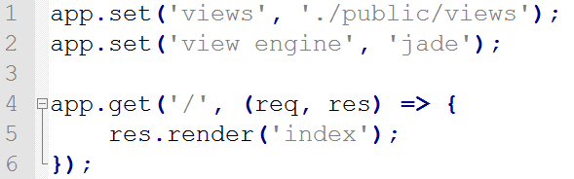
View engine
app.set(‘views’, [view path])
app.set(‘view engine’, [engine name])
Convert index.jade file to index.html based on “jade” engine

Slide 29
Overview Express
Express app
Client Request
/user/12
Route (‘/user/:id’)
Middleware
(‘/user/:id’)
…
Middleware
{response}
Client Response
View engine
{response.render}

Slide 30
Summary
Express router -> path & hander
Express view engine
Express middleware

Slide 31
Node & MongoDB

Slide 32
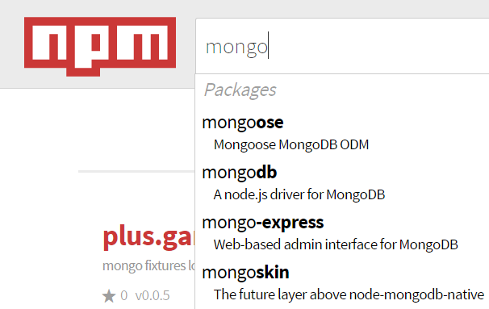
Node & MongoDB
mongoose: Object document modeling
mongodb:node-mongodb-native
mongoskin:node-mongoskin
Notes:
Mongo-expressmongo express 是一个基于Node js和express的开源的MongoDB Web管理界面

Slide 33
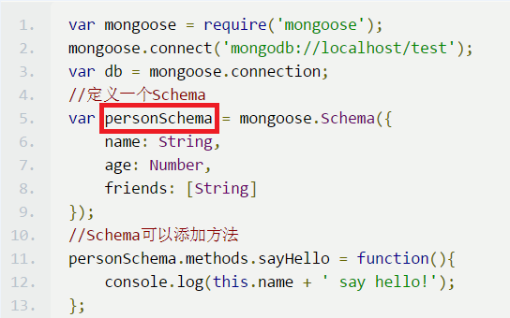
Mongoose-Schema
Schema:
Maps to a MongoDB collection
Defines the shape of the documents
Add functions.
Schema.Type
Validation
Notes:
Schema ： 一种以文件形式存储的数据库模型骨架，不具备数据库的操作能力
Model ： 由Schema发布生成的模型，具有抽象属性和行为的数据库操作对
Entity ： 由Model创建的实体，他的操作也会影响数据库

Slide 34
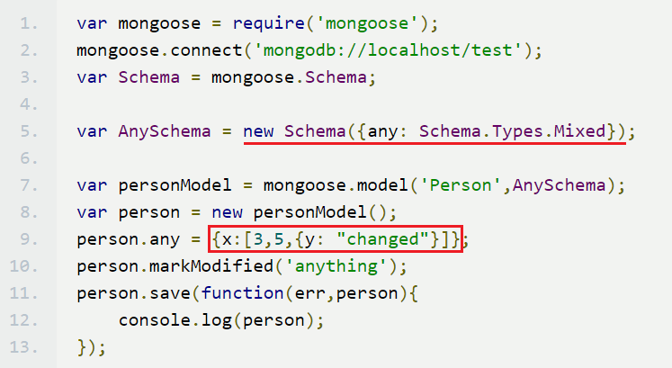
Mongoose-Schema.Type
Schema.Type: String, Number, Date, Buffer, Boolean, Mixed, ObjectId, Array.
Mixed: After Mixed, markModified()
ObjectId: Primary Key
var _someId = new mongoose.Types.ObjectId;
Notes:
Schema ： 一种以文件形式存储的数据库模型骨架，不具备数据库的操作能力
Model ： 由Schema发布生成的模型，具有抽象属性和行为的数据库操作对
Entity ： 由Model创建的实体，他的操作也会影响数据库

Slide 35
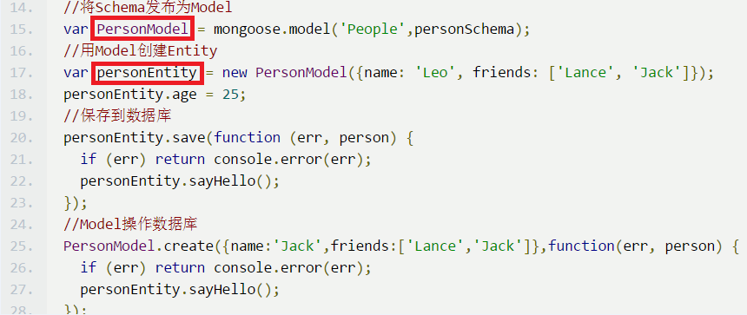
Mongoose-Model
Model:
CRUD Documents.
Naming Collection.
(Model name + ’s’). toLowerCase()= collection name
People + ‘s’ = peoples
Notes:
Schema ： 一种以文件形式存储的数据库模型骨架，不具备数据库的操作能力
Model ： 由Schema发布生成的模型，具有抽象属性和行为的数据库操作对
Entity ： 由Model创建的实体，他的操作也会影响数据库

Slide 36
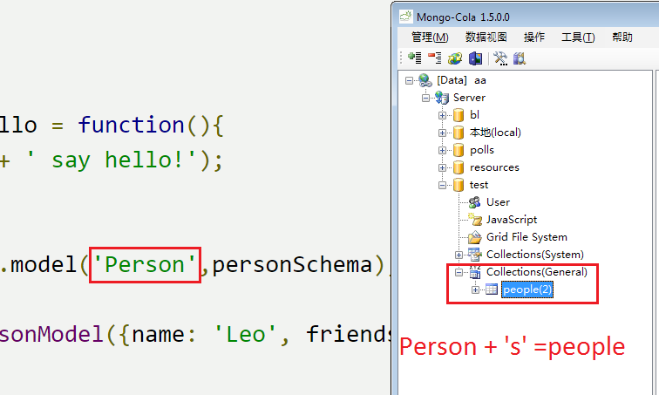
Mongoose-Model
Model:
CRUD Documents.
Naming Collection.
Notes:
Schema ： 一种以文件形式存储的数据库模型骨架，不具备数据库的操作能力
Model ： 由Schema发布生成的模型，具有抽象属性和行为的数据库操作对
Entity ： 由Model创建的实体，他的操作也会影响数据库

Slide 37
Summary-mongoose
ODM
Schema
Schema.Type
Model
Node-restful

Slide 38
Reference
Express Official Guide
Github Express – examples
Mongoose.js

